Slide 1
Module 13: Performance
SER 423

Slide 2
Considering Performance
So far we’ve been building our apps with little consideration for how anything we’re adding affects the app’s performance
This time we’re going to take a bit of a step back and look at how we can improve our performance
Remember, fast performance is important in any piece of software
  Users will almost always prefer performance over functionality and design
And mobile apps are no exception!
A lot of these tips are applicable to all types of projects, not just mobile apps
You may be familiar with a chunk of these already
So, this module will be shorter and more focused on providing tips and tricks for keeping performance optimal

Slide 3
The Threads and the Bridge Between Them

Slide 4
Why React Native Exists
Originally, apps were made in entirely native code
Quickly, JavaScript became a popular way to try to build cross platform apps
However, these apps worked by wrapping a web app in a native container
Sure, this worked, but performance was pretty stinky
React Native was specifically designed to bridge the gap between JavaScript and native functionality
While your app is running, there are two threads running - the JavaScript thread and the native thread
Both of these are fast - but the native one is significantly faster than the JavaScript one
  It has less overhead
Where you really lose performance is when you pass something from one of these threads to the other one

Slide 5
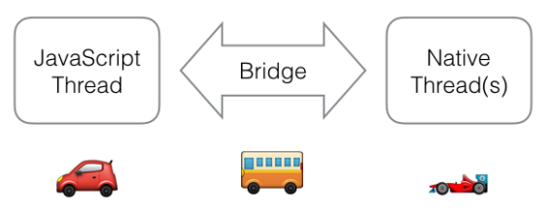
The React Bridge

Slide 6
Where is the Action?
Your react app is written in JavaScript, so most of what you write will get executed on the JavaScript thread
But again, the native thread is faster
This is why we are discussing this now, as we will take a look at building things directly in native code soon
Even with native code you will likely continue to build much, probably most, of your app in JavaScript
Remember that the bridge is a performance bottleneck
Try to keep everything made in JavaScript to only be used there, and anything written in mative kept over there
  As you might imagine, this defeats the purpose of writing both types - the key here is keep interaction to a minimum and only use the bridge when it is needed
For example - Animations actually run better in the native thread

Slide 7
Improving Performance

Slide 8
Quick Refresher - Run Times
You should already be familiar with the idea of a run time for a function or algorithm
Essentially, we can calculate the average time it will take for an algorithm to run based on the number of elements it needs to consider (n)
The higher the multiplier on n the worse performance is
  So O(n²) (exponential) is worse than O(n) (linear)
We want to have the least multiplier possible so that the total stays low even as n increases
  ie. O(log(n)) which will quickly taper off to grow slowly even as n greatly increases
The ideal situation is to achieve O(1) which is constant time where the size of n does not affect the running time
General hint - Maps and Sets are your friend!

Slide 9
Optimizing ListView
We discussed lists and you have likely used them several times since then
However, there is a problem when we have a large list
When items in the list scroll off the top, they are removed from the render tree
That’s good so that they do not display any longer
However, the references to them continue to exist in memory for as long as the component is mounted
  Oops
This means you get a memory leak type effect where performance will slowly decrease the longer the component with the list is mounted
  This is not an actual memory leak, it just acts similar

Slide 10
What We Can Change
ListView contains some properties we can set to try to help out on performance
  initialListSize - How many items to display when it is first mounted
  pageSize - How many items are displayed in the View at once
  scrollRenderAheadDistance - How early to start rendering a row, even before it is visible, in pixels
  removeClippedSubviews - A newer feature that tackles this problem head on by trimming unrendered Views on larger lists
    The book warns that this is experimental, it no longer is. Other online documentation may be out of date as well
    It is in fact now enabled by default
The View for the individual rows have an overflow property which you can set to “hidden” to let it know to not render when going off the screen
  removeClippedSubviews replies on this to know which Views to trim

Slide 11
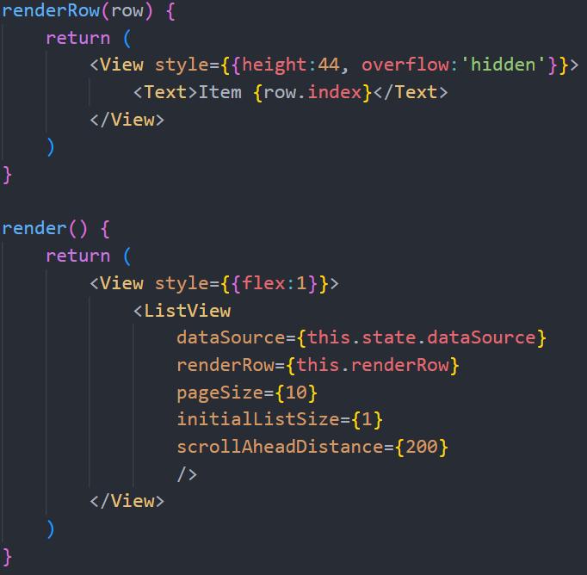
An Optimized ListView

Slide 12
Optimizing Our Custom Components
There are a few things we can do or avoid that will help performance on any components that we write ourselves
  Make sure everything in state is being used
    Don’t bloat it for no reason
    When state changes, it forces a re-render of the component
  Check render for any calculations and try to cache and store results outside of render
    Some calculations make sense to have in render (ie. size of something depending on orientation
    Make use of lifecycle hooks!
  Try to make a PureComponent
    Extend the React.PureComponent base class
    That class implements a method called shouldComponentUpdate which stops it from rendering if there has been no change to state or props

Slide 13
End of Performance
That’s all for Module 13!

